Slide 1
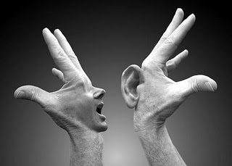
EFFECTIVE COMMUNICATION SKILLS

Slide 2
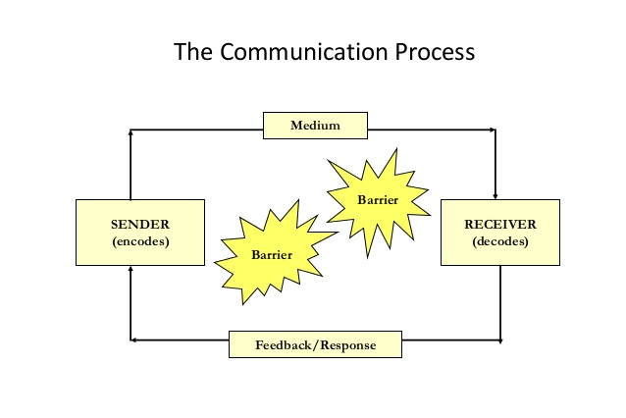

Slide 3
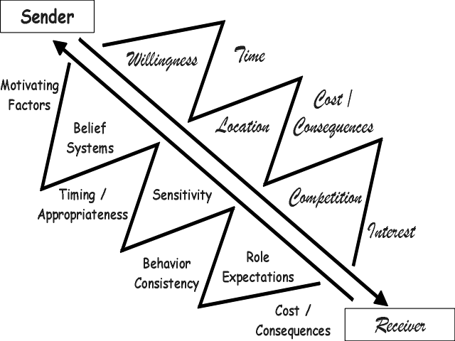
Distortions in Communication

Slide 4
Barriers of Communication
Physical Barriers
Perceptual Barriers
Emotional Barriers
Cultural Barrier
Language Barrier
Gender Barrier
Interpersonal Barrier

Slide 5
Types of Communication
Verbal/non verbal/written
According to organizational structure
Formal / Informal communication
According to Directions
Downward
Upward
Horizontal

Slide 6
ACTIVITY
DRAW A PIRAMID OF AN ORGANIZATION

Slide 7
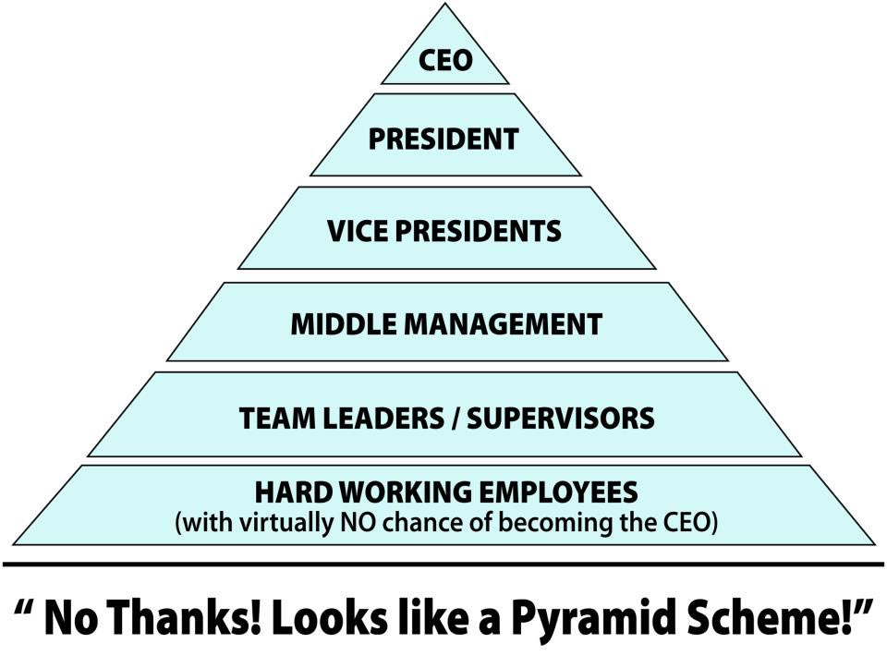

Slide 8
QUIZ
WHAT ARE THE TOP 3 TECHNIQUES TO BE EFFECTIVE IN COMMUNICATION?

Slide 9
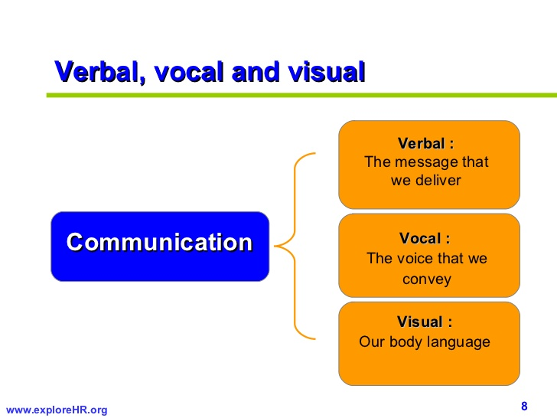
Albert Mehrabians model

Slide 10
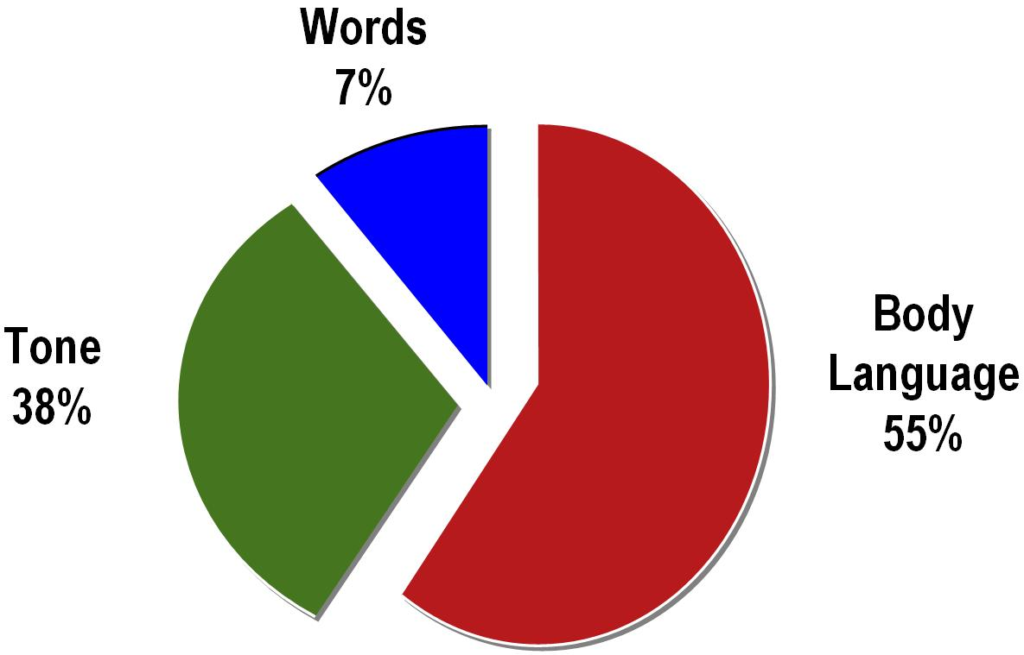
Albert Mehrabians model

Slide 11


Slide 12


Slide 13
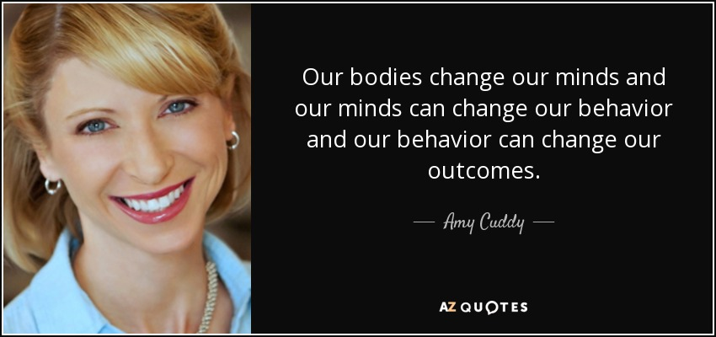

Slide 14
Your body doesn't know how to lie. Unconsciously, it telegraphs your thoughts as you fold your arms, cross your legs, stand, walk, move your eyes and mouth. The new science of kinesics deals with these physical signals that we all send out.

Slide 15
1. Body Language Speaks Volumes About You 2. Testosterone and Cortisol Affect Your Confidence 3. Power Posing May Change Your Life

Slide 16
Don’t fake it till you make it. Fake it till you become it...Do it enough until you actually become it and internalize it.

Slide 17
Nonverbal communication can play five roles:

Slide 18
GESTUES
HAPTICS
POSTURES
EYE CONTACTS
PROXEMICS
CHRONIMICS

Slide 19
TONE - SPEAKING POWERFULLY
PITCH
PACE
VOLUME
MODULATION
TONE

Slide 20
Changing meaning through word stress.
The simple sentence can have many levels of meaning based on the word you stress.

Slide 21
Example:
I didn’t say he stole money
Meaning: Someone else said it
I didn’t say he stole money
Meaning: that’s not true at all
I didn’t say he stole money
Meaning: Suggested the possibility
I didn’t say he stole money
Meaning: someone else took it

Slide 22
I didn’t say he stole money
Meaning: Maybe he just borrowed it
I didn’t say he stole money
Meaning: He may have taken some jewelry

Slide 23

POWER OF WORDS

Slide 24
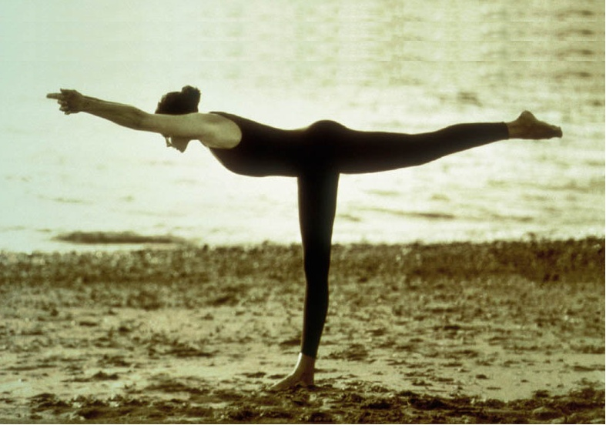

Slide 26
CHARISMATIC
CONCENTRATION
FOCUSED
BALANCED
COURAGEOUS
DEDICATION
PERSISTANCE
INTENCE EFFORTS
REMARKABLE
DETERMINED
DEMONSTRATIVE
HARD WORK
EXCELLENT
ASTOUNDING
ACTIVE
OWNERSHIP
FEARLESS
INCREDIBLE
JOYFULL
CREATIVE
ANXIOUS
RELIABLE
FABULOUS
ETERNAL
COMMITTED
ENTHUSIASTIC
DILIGENT
DEVOTION
LOYAL
FLAWLESS EXCELLENT
STRETCHING BEYOND LIMITS
ADAPTABLE
PRODIGIOUS
AFFABLE
DYNAMIC
FANTISTIC
DECISIVE
UNBELIEVEABLE
PERFECTION
COMPASSIONATE
SIGHTFUL
PRODIGIOUS
THOUGHTFUL
OPTIMISTIC
INSPIRED
EXPANSIVE
INDESTRUCTIBLE
GREGARIOUS
PASSIONATE
HONEST
POSITIVE
AWESOME
SELF-CONFIDENT
INDEPENDENT
OUTGOING
JUBILANT
SELF-DISCIPLINED
INTUITIVE
AMBITIOUS
BEUTIFUL
INCREDIBLE
MIND BOGGLING
RADICAL
EXTREME
AMAZING
EXCITING
ENCOURAGING
BEAMING EFFORT
STUDIOUS
FRIENDLY
EXCEPTIONAL
OUTSTANDING
STUNNING
DELIGHTFUL
UNMATCHED
UNBEATABLE
BOUNDLESS
ENCOURAGING
MOTIVATED
INSIGHTFUL
PRACTICAL
FIRST CLASS
ENERGETIC
BEYOND
PATIENT
RATIONAL
SENSIBLE
OUTSTANDING
WONDROUS
TOUGH
WILLING

Slide 27
Describe the personality in 1 word
Always me -
Tell always about what they have done -
Leave me alone -
Happy go lucky -
Balance of leave me alone and happy go lucky –
Avoid Human society –
A person who hates woman –
A person who follows spirituality –
A person who hates marriage –
Helping People –

Slide 28
Describe the personality in 1 word
Always me - Egoist
Tell always about what they have done - Egotist
Leave me alone - Introvert
Happy go lucky - Extrovert
Balance of leave me alone and happy go lucky – Ambivert
Avoid Human society – Misanthrope
A person who hates woman – Misogynist
A person who follows spirituality – Ascetic
A person who hates marriage – Misogamist
Helping People – Altruist

Slide 29
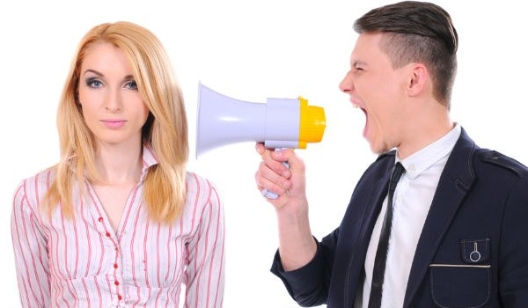
The Art of listening

Slide 30
QUIZ
------- % GIVEN FOR ACTIVE LISTENING IN THE COMMUNICATION PROCESS.

Slide 31
Listening and Speaking are used a lot…

Slide 32

Notes:
The trainer will give a word or sentence to one participants and 1 participant will pass on the same message to another…..Trainer will draw conclusion
By explaining the techniques…..

Slide 33
MRS. Right Activity
Notes:
Group Size 20 – 200+
Age Range: middle school – adult
Intensity: Mental=2, Physical=1
Time: 5-10 minutes
Space: Minimal
Set Up Time: 60 seconds
Props: 3” x 5” index cards - - one for each person
Objective
Pass the index cards around the circle, following the “right – left” directions of the “Mrs. Wright” story.
Set Up / Preparation
1. Supply each person with an index card. Have each person right their name on the card.
2. Have the group stand up and form a big circle. If the group is really large (100+) you can have them form 2 (or more) smaller circles. Actual numbers of people in each group is not important.
3. Before starting the “Mrs. Wright” activity make sure everyone has only ONE card (this is very important).
4. Inform everyone that you are about to read a story. Tell the group that during the story, if they hear the word “right”, they are to pass the card they have in their hands to the Right. If they hear the word “left” they are to pass the card they have in their hands to the Left.
5. Do a “test run” with the group. Tell the group: “I’d like to do a test run with you. Ready? Right (pause to let everyone pass their card to the Right). Left (pause to let everyone pass their card to the Left). Very good. Everyone should now have the card they started out with (your name is on your card). Now lets begin the story.”
6. This is where you start reading the “Mrs. Wright” story (see the story below). Start off slow so people can get a chance to feel successful. Then slowly speed up.
7. If everyone does their job, they will end up with their card at the end of the story.
THE STORY: “Once upon a time, Mrs. Wright took her three left handed children (Wendy Wright, Larry Wright, and Billy Wright) on a vacation. They left on a Monday and planned to return just before the Thanksgiving holiday. Billy Wright left school for the Wright vacation. Wendy left a whole plate of leftovers for her cat to eat during the Wright vacation. But Billy, who is the president of a local leftist organization, was the saddest of all. He left behind all the addresses of friends that he wanted to write to while on vacation. This mistake left Billy’s friends in the dark. By the end of the week, all the Wrights wished they had never left. They still had the weekend left, but Mrs. Wright decided that the right thing to do would be to return home right away. They arrived back at their house, which is located to the left of Yankee Stadium, in time for Thanksgiving leftovers.”
Rules
See description above.
Comments
People will quickly discover (experience) through this activity that everyone needs to pay attention. If one person isn’t doing his or her job then it has a big effect on everyone else.
Debriefing
I like to use this activity to discuss the impact our individual efforts have on the whole. For example, if one person (“Bob”) does his job well (listens to the directions and passes the cards in the correct directions) and another person (“Sally”) located 4 positions to Bob’s left doesn’t pay attention and doesn’t do her job well, this can effect the outcome for Bob (he may not end up with his card). With groups I’ve worked with in the past, this activity has successfully opened the doors to great conversations about the importance of full commitment from those involved in a project.
Variations
1. There is a great icebreaker activity I call “The Big Question” (found on this site) that involves index cards. It is a great activity to lead right before the Mrs. Wright activity.
2. If you work with young people, have them write a story of their own that works out like the “Mrs. Wright” story (it’s tricky!).

Slide 34
“Once upon a time, Mrs. Wright took her three left handed children (Wendy Wright, Larry Wright, and Billy Wright) on a vacation. They left on a Monday and planned to return just before the Thanksgiving holiday. Billy Wright left school for the Wright vacation. Wendy left a whole plate of leftovers for her cat to eat during the Wright vacation. But Billy, who is the president of a local leftist organization, was the saddest of all. He left behind all the addresses of friends that he wanted to write to while on vacation. This mistake left Billy’s friends in the dark. By the end of the week, all the Wrights wished they had never left. They still had the weekend left, but Mrs. Wright decided that the right thing to do would be to return home right away. They arrived back at their house, which is located to the left of Yankee Stadium, in time for Thanksgiving leftovers.”

Slide 35
Paraphrase
Questions
Writing notes/Taking pointers
Verbal Nodding
Genuine Interest
Body Language
Never Interrupt
Empathy
Listen Completely
SEE(Smile, Energy, Eye Contact)

Slide 36
Let us summarize
Are you listening for replying or understanding?
Are you listening the facts or feelings?

Slide 37
QUIZ
WHAT ARE THE 4 STYLES OF COMMUNICATION?

Slide 38
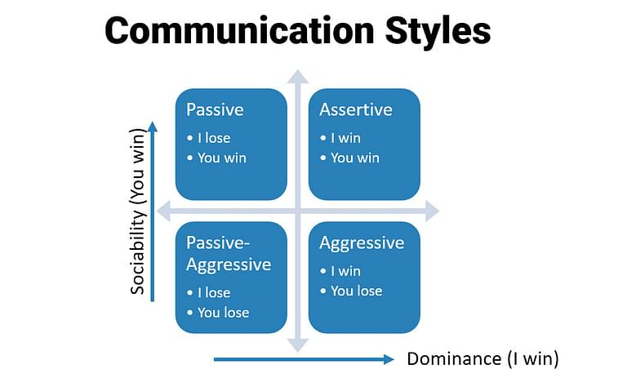
Understanding the Style

Slide 39

POWER OF ACKNOWLEDGEMENT BY ACTION WORDS

Slide 40
QUIZ
HOW MANY ACKNOWLEDGEMENT WORDS YOU CAN WRITE?

Slide 41
EMPHASIS
ADDITION
CONTRAST
ORDER
RESULT
ILLUSTRATION
COMPARISON
SUMMERY
REASON
CONDITION
CONCESSION
GENERALIZATION

Slide 42
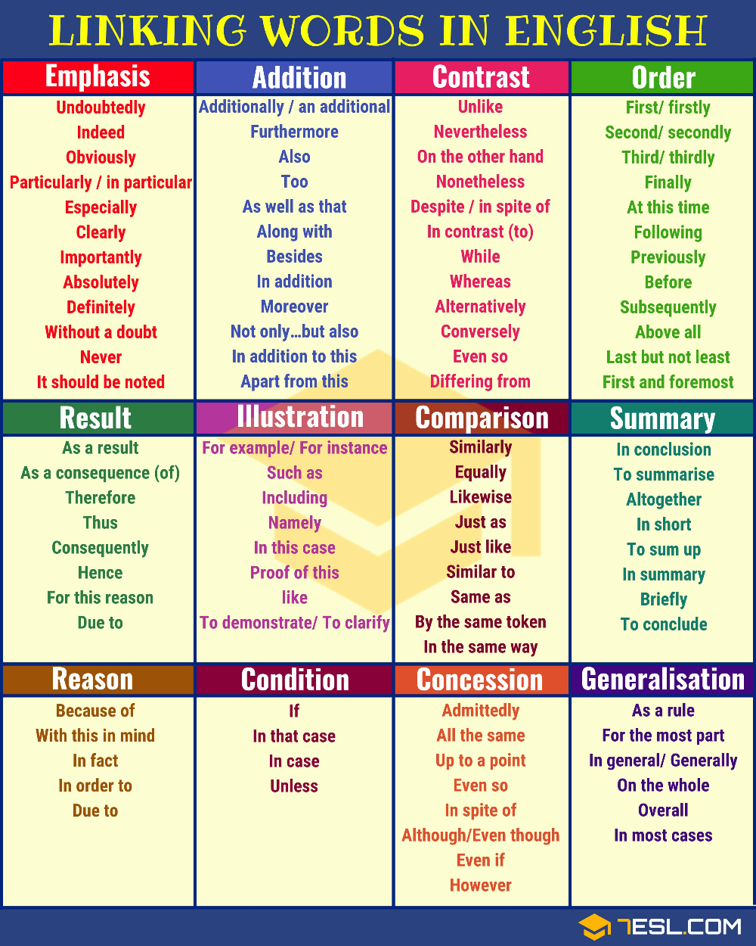

Slide 43
QUIZ
WHAT ARE COMMUNICATION CONNECTORS?

Slide 44
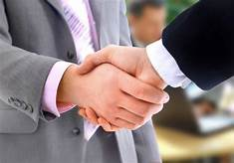

Communication Connectors

Slide 45
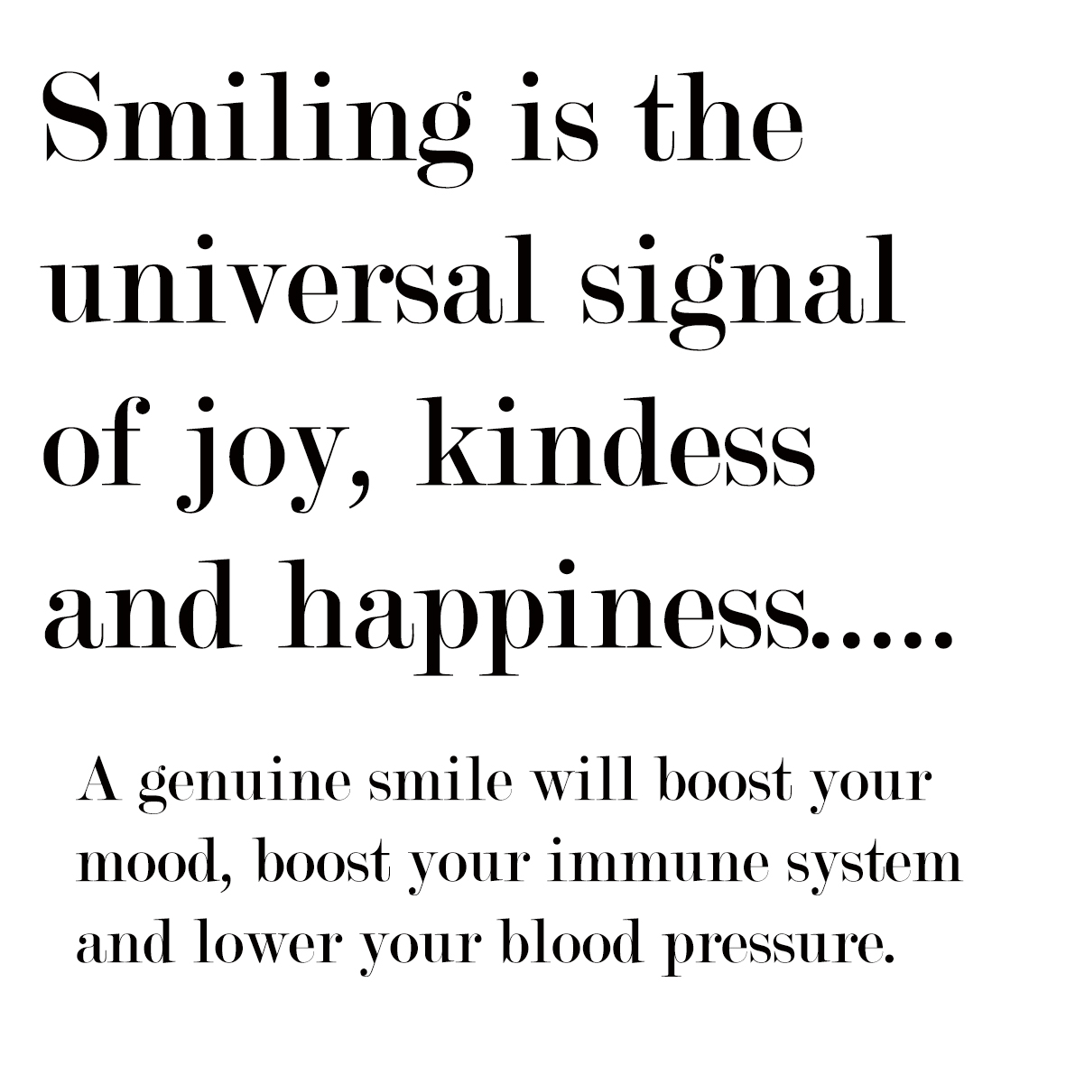
POWER OF SMILE

Slide 46
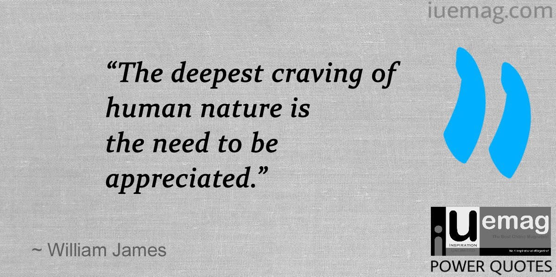
POWER OF APPRECIATION

Slide 47
Notes:
The trainer will give a word or sentence to one participants and 1 participant will pass on the same message to another…..Trainer will draw conclusion
By explaining the techniques…..

Slide 48
Effective 7 C’s

Slide 49
QUIZ
WHAT ARE THE 7Cs YOU KNOW IN THE PROCESS OF COMMUNICATION?

Slide 50
Completeness
Clarity
Consideration
Concreteness
correctness
Courtesy
Conciseness

Slide 51

Art of saying No

Slide 52
10 reasons why you should learn to say ‘NO’
It eradicates a prospective awkward situation, beforehand
Pushing your limits and going overboard won’t give out the best results
Because it’s time you set your priorities right
Saves time and energy
Saves you from the embarrassment of not faring well

Slide 53
6. Builds up your confidence
7. People stop taking you for granted
8. Gain some real respect
9. Keeps your health in check and keeps the glow on your face intact
10. Finally, your ‘yes’ is valued more

Slide 54
My Way
"Yes" to the Person, "No" to the Task
I KNOW when to say NO
Action / priority matrix
Know the Dangers of Saying "Yes" to Everything
Not Reacting, Responding

Slide 55
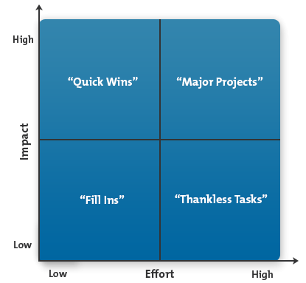
Action / Priority Matrix

Slide 56
Quick Wins (High Impact, Low Effort)
Major Projects (High Impact, High Effort)
Fill Ins (Low Impact, Low Effort)
Thankless Tasks (Low Impact, High Effort)

Slide 57

Questioning Skills

Slide 58
Why questions?
To obtain information
To help maintain control of the conversation
Express an interest in the other person
To clarify a point
To understand personality
To test knowledge
To encourage further thought
In group situations

Slide 59
Types of questions
Closed questions
Open questions
Leading questions
Rhetorical questions
Funneling questions

Slide 60
Closed ended questions
Closed questions have two possible answers depending on how you phrase it: “yes” or “no” or “true” or “false.” You can use closed questions to get direct information or to gauge someone’s knowledge on a topic.

Slide 61
Closed Ended question
Did you see Ramesh today?
What is the square root of four?
Do you want me to call that client?

Slide 62
Open ended question
Open questions are the opposite of closed questions in that they facilitate lengthier, more thoughtful answers and discussions among groups. These questions don’t invite “yes” or “no” responses and instead encourage the listener to respond with detail.

Slide 63
Open ended question
What is the best way to learn about cooking?
Why did you leave the meeting early?
What was your first work experience?

Slide 64
Leading question
Leading questions encourage the listener to provide a specific response. Often, speakers phrase these questions to encourage the listener to agree with them. It’s a good idea to use these questions sparsely, as others may view them as manipulative if you use them frequently or in the wrong context.

Slide 65
Leading question
Don’t you think that sales call went well?
Wouldn’t you like it if you could guarantee automation for that process?

Slide 66
Rhetorical questions
Rhetorical questions illustrate a point or focus attention on an idea or principle. Because speakers use rhetorical questions to persuade others, these questions typically don’t require a response. You’re less likely to use rhetorical questions in everyday conversations with colleagues, but you may use them in formal presentations, speeches or sales pitches.

Slide 67
Rhetorical questions
Who cares if the park closes?
Who will maintain the city’s infrastructure if the council cuts this budget?

Slide 68
Funneling questions
Unlike other types, funnel questions are always a series of questions. Their sequence mimics a funnel structure in that they start broadly with open questions, then segue to closed questions. The sequence can also take the opposite form, such as starting narrowly with straightforward closed questions and broadening into subjective open questions.

Slide 69
Funneling questions
Did you enjoy the presentation?
What did you like most about it?
What sorts of things would you have liked to add to the presentation?

Slide 70
Notes:
I will remember 1 object which we are using in the office and all the participants will try to find the answer.

Slide 71
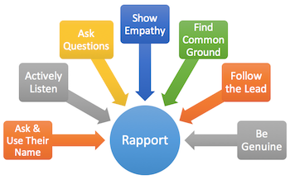
RAPPORT BUILDING

Slide 72
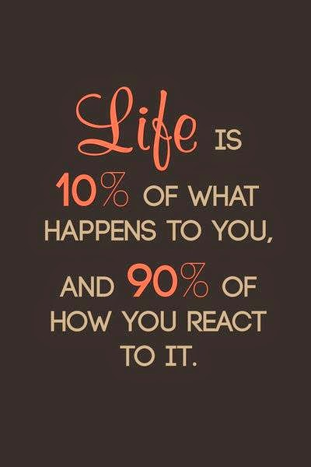
90 -10 principle to communicate

Slide 73

EFFECTIVE
PUBLIC SPEAKING

Slide 74

USES OF PUBLIC SPEAKING
Public speaking can serve the purpose of transmitting information, telling a story, motivating people to act or encouraging people.
Training / Motivating session
Media / Press Meet
Business Conference
Party Conference
Stage Presents, Etc . .

Slide 75

Becoming more knowledgeable
Improve communication skills
Boost confidence
Learn to persuade
Build leadership skills
Expand your professional network
Personal satisfaction
Honing critical thinking and listening skills
Career advancement
Accomplishing professional and personal goals
Exploring and sharing values
Make new social connections
BENEFITS OF
PUBLIC SPEAKING
We’ve listed the top benefits of public speaking, which will encourage you to get out of your comfort zone and sign up to speak at a few events in the future.

Slide 76

5 ESSENTIAL ELEMENTS IN SUCCESSFUL
PUBLIC SPEAKING
Overcoming Your Fear
Knowing Your Audience
Researching Your Topic
Having a Personality
Encouraging Audience Participation

Slide 77
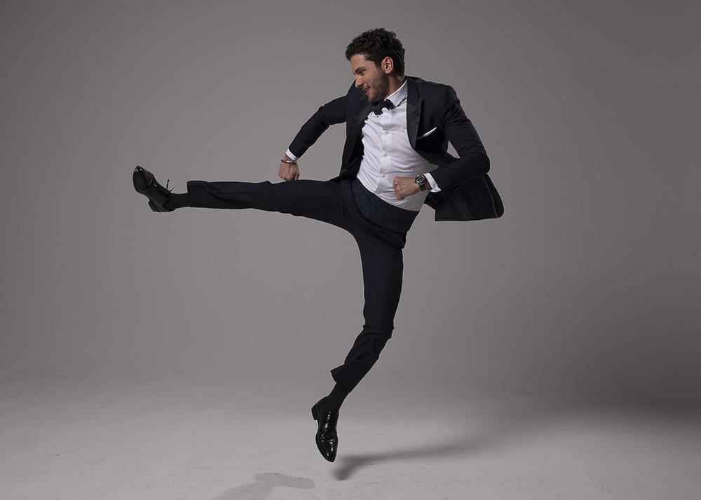
The Three E’s
In order to become an effective speaker, always remember the three E’s:
Energize
Entertain
Educate

Slide 78
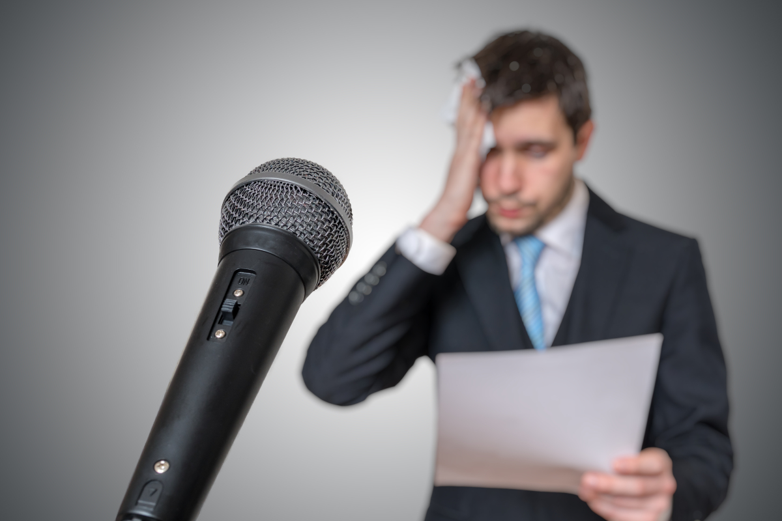
YOU CAN REDUCE STAGE FRIGHT BY
Preparation & rehearsing 75%
Deep breathing 15%
Mind Control 10%
Notes:
Overcoming Stage Fright
Butterflies. The jitters. A bad case of nerves. Fear of speaking in public is called “stage fright” but it begins long before one gets to the stage. For many it begins the minute they get the invitation to speak. Some fear their audience, and the more you fear your audience, the more nervous you become. Actually audiences are usually sympathetic to stage fright. Even if they notice you are frightened they usually attempt to encourage a speaker. Here are some tips to help you overcome fear:

Slide 79

Do!
Don’t
Stick to key points
Articulate clearly
Aim for the right level
Use stories and examples
Understand the political culture
Use simple language
Don’t Just reading from your notes / Slides
Don’t use jargon or acronyms
Don’t overwhelm with statistics
Don’t use sarcasm
Do not lean on podium
Don’t go over your allotted time

Slide 80
